Slide 1
Guru Nanak Institute of Technology
Department of CSE
Major Project Abstract: A.Y:2017-18
Modifying Pixel Properties In Adaptive Steganography Using Substitute Method
By
D AKHILA (14831A0537)
ADICHERELA VENKATASAI (14831A0505)
J SRIKANTH (14831A0558)
Under the Guidance of
Mr. NUSRATH KHAN
(Associate Professor)
Internal Guide Project Coordinator HOD

Slide 2
Modifying pixel properties In Adaptive Steganography Using Substitute Method
Abstract:
In steganography, the distortion purpose is used to explain the modification cost on cover elements ,which are definitely crucial to the security of current adaptive steganography.. In this project, we suggest a novel cost reassignment rule that's implemented to not one but a batch of present distortion functions. We notice that the costs assigned on a few pixels by several steganographic strategies may be very dissimilar even though those strategies exhibit close security levels. Such pixels are named as “controversial pixel”. Experimental results display that steganalysis features are unresponsive to those pixels, therefore these pixels are appropriate to hold extra payloads. We name this rule as the Controversial Pixels Prior (CPP) rule. steganalysis features and cover databases, we exhibit that the CPP rule can enhance the security of state-of-the-art steganographic algorithms for spatial snapshots

Slide 3
Existing system
It defines distortion functions by investigating how to reasonably define the complex degrees of pixels in the sense of resisting detection.
The core idea of Complexity Prior, several effective rules for ranking priority of pixels have been proposed by previous works
Cost spreading rule: An element with high priority should spread its high rank to its neighbourhood and vice versa(low priority)
This is also called as clustering rule
SMD rule(synchronizing modification rule): The rule of synchronizing the modification direction ,which means the neighbouring pixels changedd in the same direction i.e; +1 or -1

Slide 4
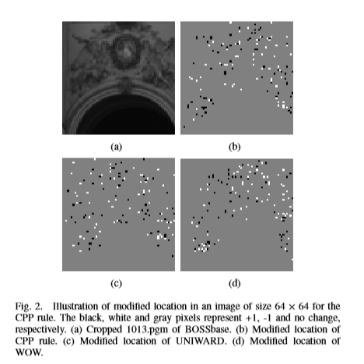
Existing system

Slide 5
Proposed System
The costs assigned on a few pixels by means of numerous steganographic strategies may be very distinct even though those strategies show off close security levels.
Experimental effects display that stega analysis capabilities are not touchy to arguable pixels; therefore these pixels are appropriate to hold extra payloads. We name this rule the controversial Pixels earlier (CPP) rule.
The CPP rule considers a combination of several existing methods instead of remaining fixed on a single method.
An essential principle in selecting candidate algorithms for the CPP rule is that basic methods have comparable security performances.
In addition, the CPP rule provides a novel tool for designing steganographic schemes

Slide 6
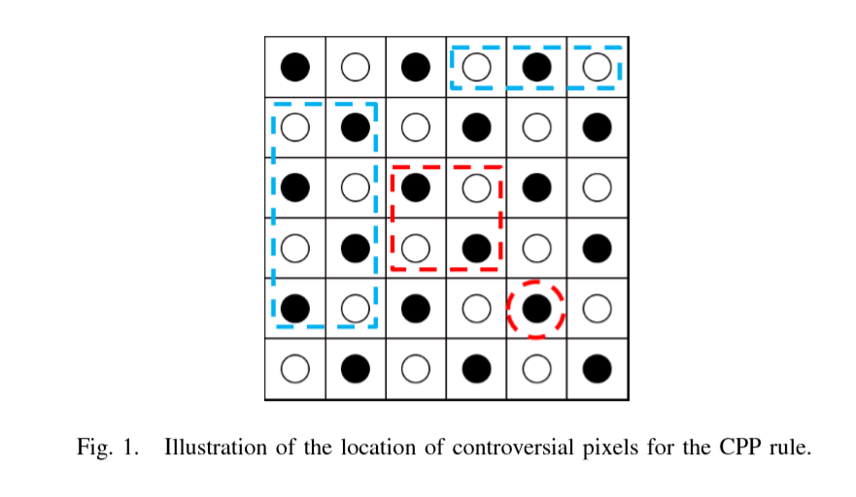
Proposed System

Slide 7
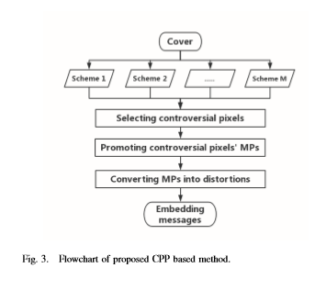

Slide 8
Existing Vs Proposed
Drawbacks | Advantages
Moderate distortion | Noise reduction
Noise is high | Improved distortion

Slide 9
Future Enhancement
The proposed framework reduces the design of secure steganography in empirical covers to the problem
By working out the proposed methodology in detail for a specific choice of the distortion function, we experimentally validate the approach and discuss various options available to the steganographer
Current model-preserving (CMP) steganographic algorithm is used
We make a connection between steganography design by minimizing embedding distortion and statistical physics
We provide a complete theoretical framework and describe practical tools, such as the thermodynamic integration for computing the rate-distortion bound

Slide 10
Proposed vs future
ENRICHMENT | EXTRAVAGANCE
Noise reduction | Thermodynamic integration.
Improved distortion rate | Rate-distortion bound.

Slide 11
Requirements
SOFTWARE REQUIREMENT
Operating system :- Windows7(with service pack1),8,8.1 and 10
Front End :- Microsoft Visual Studio .Net 2013
Coding Language :- C#
Backend :- SQL Server 2012
HARDWARE REQUIREMENT
Processor : Pentium Dual Core 2.00GHZ
Hard disk : 120 GB
Mouse : Logitech.
RAM : 2GB(minimum)
Keyboard : 110 keys enhanced

